Slide 1
Chapter 5 Loops
Liang, Introduction to Java Programming, Tenth Edition, (c) 2015 Pearson Education, Inc. All rights reserved.

Slide 2
Ending a Loop with a Sentinel Value
Often the number of times a loop is executed is not predetermined. You may use an input value to signify the end of the loop. Such a value is known as a sentinel value.
Write a program that reads and calculates the sum of an unspecified number of integers. The input 0 signifies the end of the input.
SentinelValue
Run

Slide 3
Caution
Don’t use floating-point values for equality checking in a loop control. Since floating-point values are approximations for some values, using them could result in imprecise counter values and inaccurate results. Consider the following code for computing 1 + 0.9 + 0.8 + ... + 0.1:
double item = 1; double sum = 0;
while (item != 0) { // No guarantee item will be 0
sum += item;
item -= 0.1;
}
System.out.println(sum);

Slide 4
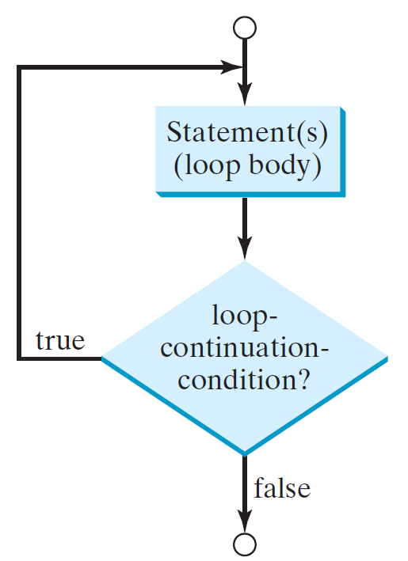
do-while Loop
do {
// Loop body;
Statement(s);
} while (loop-continuation-condition);

Slide 5
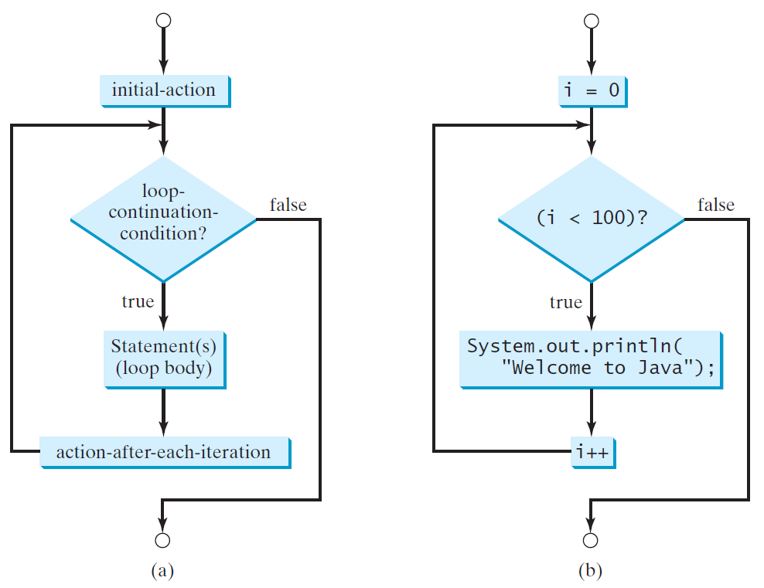
for Loops
for (initial-action; loop-continuation-condition; action-after-each-iteration) {
// loop body;
Statement(s);
}
int i;
for (i = 0; i < 100; i++) {
System.out.println(
"Welcome to Java!");
}

Slide 6
Trace for Loop
animation
Declare i
int i;
for (i = 0; i < 2; i++) {
System.out.println(
"Welcome to Java!");
}

Slide 7
Trace for Loop, cont.
animation
Execute initializer
i is now 0
int i;
for (i = 0; i < 2; i++) {
System.out.println(
"Welcome to Java!");
}

Slide 8
Trace for Loop, cont.
animation
(i < 2) is true
since i is 0
int i;
for (i = 0; i < 2; i++) {
System.out.println( "Welcome to Java!");
}

Slide 9
Trace for Loop, cont.
animation
Print Welcome to Java
int i;
for (i = 0; i < 2; i++) {
System.out.println("Welcome to Java!");
}

Slide 10
Trace for Loop, cont.
animation
Execute adjustment statement
i now is 1
int i;
for (i = 0; i < 2; i++) {
System.out.println("Welcome to Java!");
}

Slide 11
Trace for Loop, cont.
animation
(i < 2) is still true
since i is 1
int i;
for (i = 0; i < 2; i++) {
System.out.println("Welcome to Java!");
}

Slide 12
Trace for Loop, cont.
animation
Print Welcome to Java
int i;
for (i = 0; i < 2; i++) {
System.out.println("Welcome to Java!");
}

Slide 13
Trace for Loop, cont.
animation
Execute adjustment statement
i now is 2
int i;
for (i = 0; i < 2; i++) {
System.out.println("Welcome to Java!");
}

Slide 14
Trace for Loop, cont.
animation
(i < 2) is false
since i is 2
int i;
for (i = 0; i < 2; i++) {
System.out.println("Welcome to Java!");
}

Slide 15
Trace for Loop, cont.
animation
Exit the loop. Execute the next statement after the loop
int i;
for (i = 0; i < 2; i++) {
System.out.println("Welcome to Java!");
}

Slide 16
Note
The initial-action in a for loop can be a list of zero or more comma-separated expressions. The action-after-each-iteration in a for loop can be a list of zero or more comma-separated statements. Therefore, the following two for loops are correct. They are rarely used in practice, however.
  for (int i = 1; i < 100; System.out.println(i++));
  for (int i = 0, j = 0; (i + j < 10); i++, j++) {
  // Do something
  }

Slide 17

Note
If the loop-continuation-condition in a for loop is omitted, it is implicitly true. Thus the statement given below in (a), which is an infinite loop, is correct. Nevertheless, it is better to use the equivalent loop in (b) to avoid confusion:

Slide 18
Caution
Adding a semicolon at the end of the for clause before the loop body is a common mistake, as shown below:
Logic Error
for (int i=0; i<10; i++);
{
System.out.println("i is " + i);
}

Slide 19
Caution, cont.
Similarly, the following loop is also wrong:
int i=0;
while (i < 10);
{
System.out.println("i is " + i);
i++;
}
In the case of the do loop, the following semicolon is needed to end the loop.
int i=0;
do {
System.out.println("i is " + i);
i++;
} while (i<10);
Logic Error
Correct

Slide 20
Recommendations
Use the one that is most intuitive and comfortable for you. In general, a for loop may be used if the number of repetitions is known, as, for example, when you need to print a message 100 times. A while loop may be used if the number of repetitions is not known, as in the case of reading the numbers until the input is 0. A do-while loop can be used to replace a while loop if the loop body has to be executed before testing the continuation condition.

Slide 21
Formatting Output
Use the printf statement.
  System.out.printf(format, items);
Where format is a string that may consist of substrings and format specifiers. A format specifier specifies how an item should be displayed. An item may be a numeric value, character, boolean value, or a string. Each specifier begins with a percent sign.

Slide 22

Frequently-Used Specifiers
Specifier Output Example
%b a boolean value true or false
%c a character 'a'
%d a decimal integer 200
%f a floating-point number 45.460000
%e a number in standard scientific notation 4.556000e+01
%s a string "Java is cool"

Slide 23
FormatDemo.java
The example gives a program that uses printf to display a table.
Page 148 Listing 4.6
FormatDemo
Run

